Slide 1
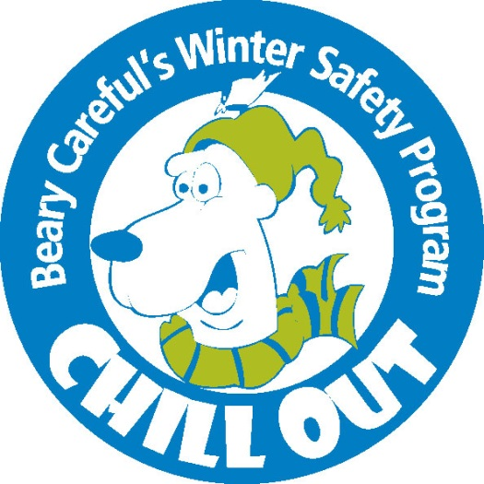

Slide 2
There are a lot of fun activities we can do in the winter like sledding, skiing, snowmobiling, ice skating and building snow forts.
What winter activity is your favorite?

Slide 3
There are certain steps we should take to stay safe when doing any outdoor winter activity.
Dress for the weather
Use proper gear and wear a helmet when going fast
Take a buddy with you
Ask permission from an adult
Notes:
Dress for the Weather – dress appropriately and in layers: hat, gloves, pants, snowpants, shirt and/or sweatshirt, coat, socks, boots.
Use proper gear and a helmet if you are doing something fast – helmets protect your brain – how many legs do you have? how many arms do you have? how many eyes? Ears? How many brains do you have? That’s right, you only have one brain, you don’t have a spare so you need to protect it.
Take a buddy with you – If you got hurt and were alone, how would you get help? If you had a buddy with you, they could help you or go get help for you.
Always ask permission from an adult – It is important for grownups to know where you are at always. If something happened to you, they need to know where you are in case you don’t come back when your supposed to, or maybe they know the hill your going sledding on is not a safe one, or they just heard on the news this morning that someone fell through the ice on the lake you want to go play hockey on – even grown-ups tell someone where they are going. We maybe don’t have to ask permission, but if I don’t come home today at the expected time, my husband will know that I was here today and he could look for me here.

Slide 4
Let’s watch a video about Beary Careful and his friends. They are going to teach us more about the four important steps for winter safety.
https://youtu.be/Nf0C7Rzezq4
Notes:
Things to point out during or after the video:
When Beary is not making good choices and isn’t being safe, he isn’t having fun and he looks scared.
Notice when Beary is following all 4 steps, he is smiling and having fun!
It is also important to have friends who help you make good choices.
Do you need to wear a helmet ice fishing? No, because you are not doing something fast, but you should wear a hat and dress for the weather, dress in layers.
Never go on the ice near open water or on top of running water.
Pulling a sled behind a snowmobile sounds fun, but it is dangerous. When the snowmobile stops what is going to happen to the person on the sled? They are going to either get flung off the sled, possibly hitting a tree or something worse, or they are going to hit the back of the snowmobile.

Slide 5
What kinds of activities (winter or summer) should we wear a helmet for?
Why should we wear a helmet?
Notes:
What kinds of activities should we wear a helmet for:
Summer: biking, scootering, horseback riding, skateboarding, football, when on an ATV/dirtbike
Winter: Snowmobiling, skiing, snowboarding, sledding, ice skating, hockey
You must always wear a full-face helmet when riding on a snowmobile, and you must be at least be 12 years old AND complete a safety class to drive a snowmobile.
Why should we wear a helmet:
Our brain is in our head and is what controls the rest of our body.
It helps us talk to each other, do fun activities, and learn.
Our brains can be hurt when going fast. Different than when we fall on the playground and get a bruise or scab, our head heals differently.
Helmets help protect our heads and brain.
The best of the best in the world wear helmets. Even Olympians wear their helmets!
Head injuries can change your life forever.

Slide 6
Let’s review the four safety steps one more time.
Try and guess the safety step using the picture as a clue.

Slide 7
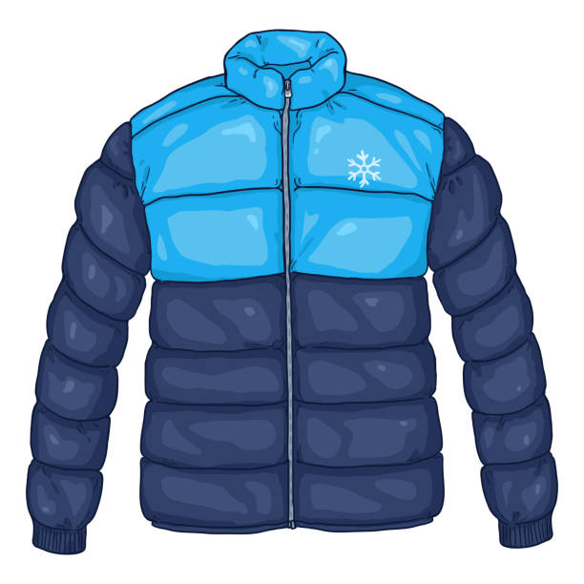

Slide 8
Dress for the weather

Slide 9
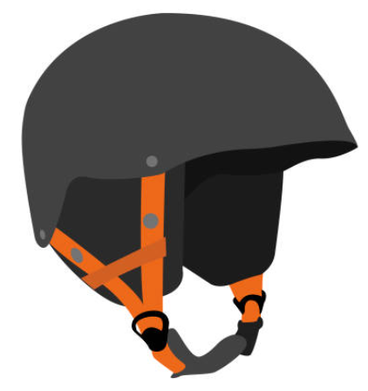

Slide 10
Use proper gear and wear
a helmet when going fast

Slide 12
Take a buddy with you

Slide 14
Ask permission from an adult

Slide 15
Today you get to take home your very own Beary Careful coloring book!
Your homework is to read this with an adult and tell them what you learned about winter safety.

