Slide 1
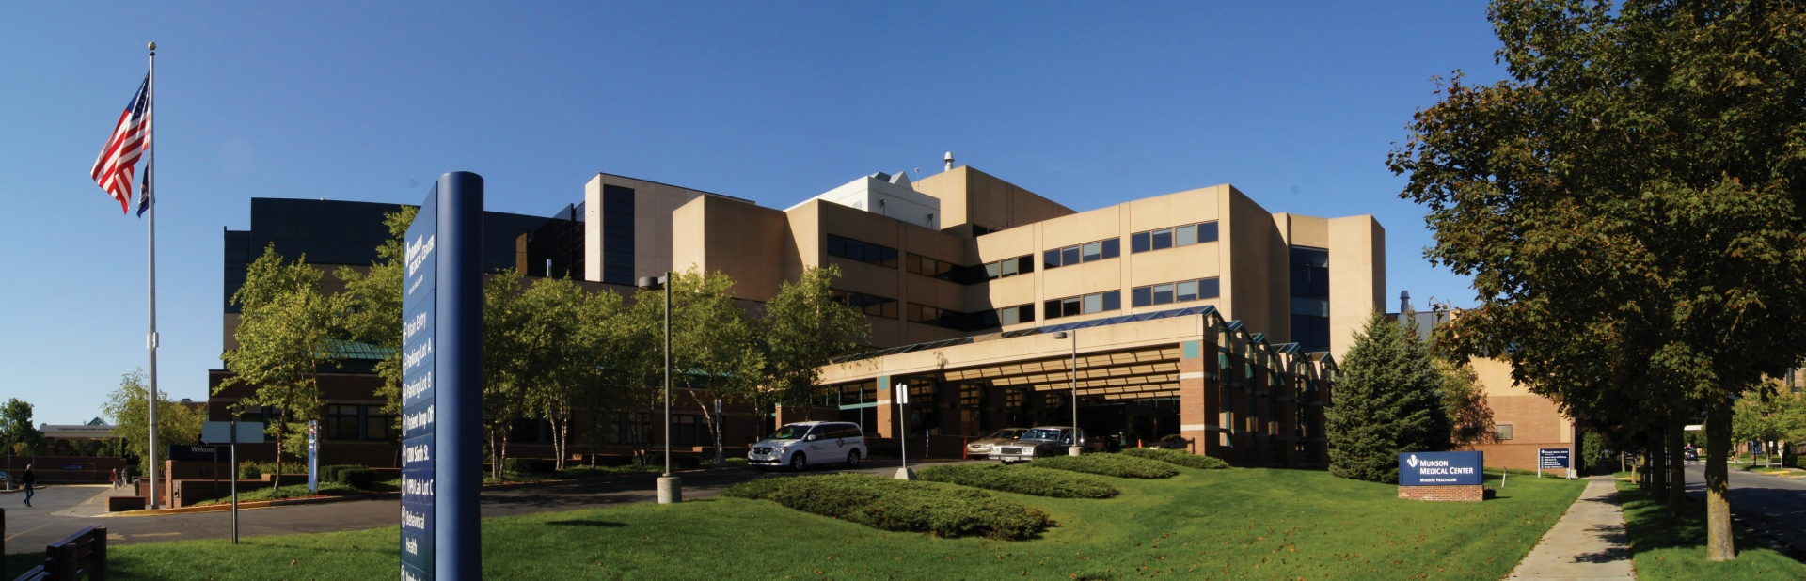

Nursing Student Orientation
For questions, please contact:
Jenn Standfest, Director of Nursing Practice
(231) 392-8298
John Bolde, Director of Safety and Security
(231) 935-6798

Slide 2
Course Goal and Objectives
Munson Medical Center is dedicated to the health, safety and welfare of our patients, their families, our staff, and our volunteers.
Course Goal: Provide introductory hospital and safety information to nursing students at Munson Medical Center.
Course Objectives:
Describe specific safety behaviors used at Munson Medical Center
Identify ways YOU can contribute to a safe environment, safe team, and safe patient care
Understand YOUR role in at least two emergency codes
List two specific patient safety goals and how YOU contribute to them
Describe how to report staff, patient, or environmental safety concerns
Safety is a personal and professional responsibility of every employee, every day.

Slide 3
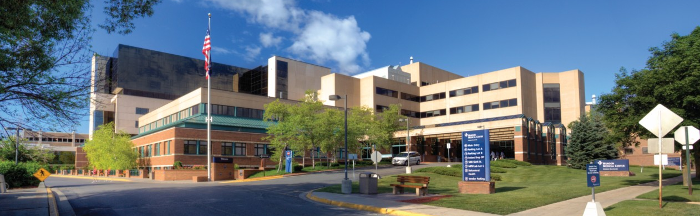
Our Mission & Vision
Munson Medical Center
Mission
Munson Medical Center and its partners will work together to provide superior quality care and promote community health.
Vision
We will be the overwhelming first choice of patients, physicians, and employees, supporting high-quality care closest to home across northern Michigan.
Notes:
This is what we’re called to do here
As a system of affiliated entities within Munson Healthcare, each one of us had our own mission. But as we came together as a more integrated system, earlier this year it became clear that we need to move toward a single mission to ensure we are all moving effectively.
This is our current vision which is in the process of being revised.

Slide 4
Our Values
Munson Medical Center
Accountability: We are accountable to our patients and each other for our decisions
Respect: We respect everyone, everywhere, everyday
Stewardship: We carefully use resources entrusted to us
Compassion: We show compassion and understanding in all of our encounters with others
Teamwork: We approach all of our work with a spirit of collaboration
Safety: We make safe work practices a top priority every day
Notes:
Our values are the behaviors that are expected by the people who do the work of the organization every day. Our six key values are:
Accountability: We are accountable to our patients and each other for our decisions.
Respect: We respect everyone, everywhere, everyday.
Stewardship: We carefully use resources entrusted to us.
Compassion: We show compassion and understanding.
Teamwork: We approach all of our work with a spirit of collaboration.
Safety: We make safe work practices a top priority every day.

Slide 5
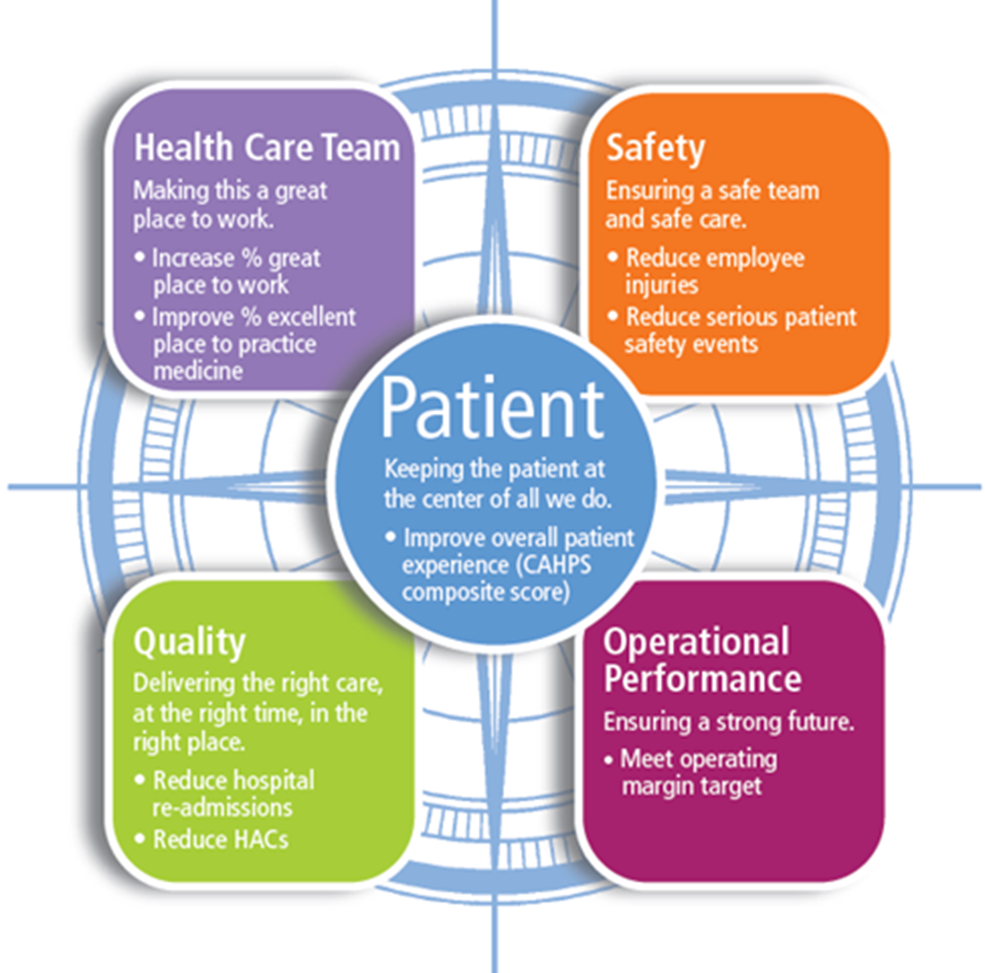
True North: Keeping the Patient at the Center of All We Do…
Notes:
True North is the compass that points our leaders and our teams in the right direction.
All of our plans flow from these areas of focus: Health Care Team, Safety, Quality, and Operational Performance – keeping the patient at the center of all we do.
When leaders and managers think about setting new system goals and pursuing opportunities, the first thing they’ll look at is True North and ask, “How does this particular plan fit into the True North framework?”
To track our progress, we have developed an organizational scorecard with key metrics such as:
Patient feedback to assess their experience and care;
health care team surveys to gauge the percentage of people who feel that Munson Healthcare is a great place to work;
patient and employee safety events to track injuries and good catches
data analysis to identify quality issues such as hospital re-admissions and hospital acquired conditions
operating margin to ensure we are financially strong
But, how do WE contribute to the True North metrics? How do we continue to strive for improvements in our care that bring value to our patients and our community? That’s what we want to talk about a little bit today…

Slide 6
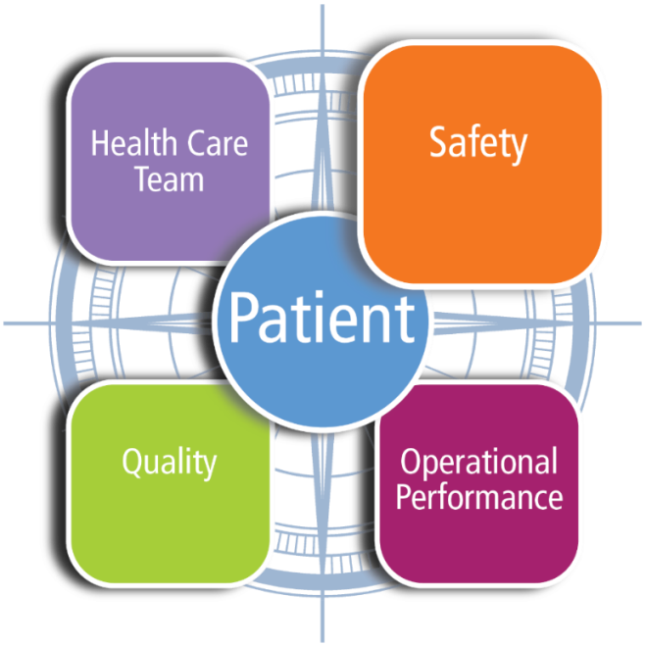
Foundations of Safety Culture
Safe Team + Safe Care = ZERO Harm
“We cannot have safe patient care without providing a safe environment for our employees first”
The information in the publication is confidential, intended solely for the internal use by Munson Healthcare and its employees, and is provided solely for patient safety improvement and educational purposes.
Notes:
This human error prevention training helps build the foundation for a new culture. It helps us establish expected safety behaviors for our organization. A safe culture improves not just harm to patients, but less injuries to employees, better patient experience, and improved employee engagement scores. You are one of the new safety champions for Munson Healthcare in their High Reliability Journey. You will be trained in understanding the basics of human error, something all of us exhibit every day, and new behaviors and tools to use in preventing these errors from occurring. You will also become familiar with the new “tones” we should all use more in a safety culture. These tones will directly effect how our patients view their overall experience while at MHC.
A toolkit will be established for MHC that will assist with creating new behaviors to better reduce errors everyday. The keys are to first explain how errors occur everyday, then what behaviors should be adopted, and what tools can be used to prevent them from occurring. Then finally how you can eventually make these behaviors every day habits. Many hospitals that have created similar training programs have eventually not only shown decreases in errors or mistakes from occurring, but as well up to 80% fewer harm events to patients and employees within 18-24 months.
Becoming a trainer will also help you lead the engagement of all staff in the safety transformation. A key goal is that all staff, including physicians, complete this basic training. Then all will understand better when to have “questioning attitude”, or how to “speak up using ARCC”, regarding a workers or patient safety issue. Communication tools such as the use of phonetics, or a numeric, or SBAR will become universally known and used in MHC, just at they are with airline pilots.
Commitments will be made to make these behaviors habits for all staff. Training all of the staff will also help build the culture and commitments all will make everyday when they arrive at work. The “One Safety” focus will also be repeatedly used and referred to as we will focus efforts on both preventing harm to our patients as well as our employees. Peer checking a co-worker so he/she is less likely to lift a patient the wrong way will be done just as it is expected when a nurse could be providing the wrong type if medication to a patient.
So after completing the training, you will be equipped with new knowledge and skills to better train all staff and spread the word on MHC’s new focus on patient and employee safety. You will be one of the new safety champions, and you will have the skills to help create many more champions in the years to come.
The trainings you will provide will be expected to be 2 hours in length, and you will complete all slides and videos in the presentation. Options to present are alone, or with another colleague. If presenting with a colleague, the recommendation is to have clinical and non-clinical trainers do them together. You can also lead a unit based effort to train units such as ICU, ED, or the Radiology department. Most staff will attend general trainings provided on a regular monthly basis.
Congratulations on becoming one of the new safety champions and leaders for MHC!

Slide 7
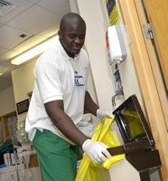
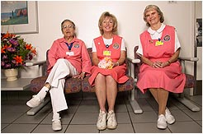

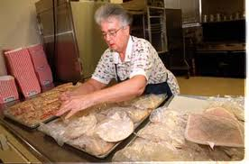
Safety is Everyone’s Job
A Washington environmental services worker stores a clear cleaning fluid in an container used for dye. A patient is later injected with the fluid.
Texas hospital volunteers saw a new mom and dad in need of help. They assisted the new parents to the front door, pushing the wheelchair for dad. The couple had just snatched the baby from a birthing room while mom slept.
An Indiana building services worker replaces a broken shower curtain rod on a behavioral health unit. The first rod broke (as intended) during a suicide attempt. The replacement rod was not the approved break-away type. The second attempt was successful.
Improperly stored chicken salad caused 3 patient deaths at a Louisiana hospital. Another 42 patients as well as 12 staff became ill after eating the contaminated food. The incident caused the resignation of two administrators as well as many staff and policy changes.
Notes:
These are all true stories around the country where people not in direct patient care roles have been part of events that have caused harm or even death.
The purpose is to illustrate how safety is everyone’s job.
Key point: We ALL have a role in keeping our patient’s and our employees safe. Every role at MHC is as important as the other in keeping everyone safe. (Includes Direct & Non Direct patient care roles)
We cannot have safe patients without safe employees to deliver the safe care. And likewise, we cannot have high quality and excellent patient experience without safe care. As has been said by patients many times, “First ,don’t harm me, then take good care of me, then be nice to me.”
.

Slide 8
Five Safety Behaviors – What Can I Do?
Prepare for the Day
Daily Huddle
Questioning Attitude
Support the Team
Peer Checking, Peer Coaching
Attention to Detail
Timeouts
Clear Communication
Verify & Validate
3-Way Repeat Backs
SBAR
Phonetic/Numeric Clarification
Speaking up with ARCC
STAR: Stop. Think. Act. Review.
Ask a question
Make a Request
Voice a Concern – Use safety phrase: “I have a concern.”
If no response, use the Chain of Command.
Situation: what is the problem, patient or project?
Background: what is the relevant information?
Assessment: what is your read of the problem?
Recommendation: what is your request or recommendation?
Notes:
This starts the part of the training where we learn the behaviors, the tools and the tones. These are 5 basic behaviors that work, and are used all the time in other industries now like nuclear power, air traffic control, airlines, and construction. These are highly reliably organizations that cannot afford a single major event, so multiple habits are formed to help prevent errors from occurring at all.
These behaviors were first developed by the Nuclear Power industry 30 years ago. In this industry, mistakes cannot happen, so the focus on behavior training was a key. These were called Human Performance Improvement tools, and included 8-10 basic expected behaviors.
Can we afford a single major event in our hospital? HIV from a needlestick? A back injury to a nurse where she loses her job, a death or permanent harm to a patient we are taking care of that we could have prevented by simply using these behaviors? That is the question we all have to answer. Are we really serious about this?
5 Behaviors and 9 tools

Slide 9

Questioning Attitude
Speak Up for Safety Using ARCC
A responsibility to protect in a manner of mutual respect –
an assertion and escalation technique
Using the lightest touch possible:
Ask a question
Make a Request
Voice a Concern
If no success…
Use Chain of Command
Safety Phrase:
“I have a concern…”
Notes:
Speak-up for safety using ARCC technique (ask, request a change, voice a concern, and use chain of command) was first published in commercial aviation as inquiry-advocacy-assertion. The protocol was intended to help first officers (co-pilots) speak-up to the captains.
The technique is intended to start with an earnest question and progressively increase in assertiveness until the condition prompting the question is resolved to the satisfaction of all. The idea behind the technique is to avoid coming on too strong when a simple question would have sufficed.
Whenever any care provider thinks that the apparent plan of action is not the best for the patient, anyone present should ask the question. This is called hint and hope. If we hint, then maybe others will recognize the problem and resolve the problem without any further effort on our part.
If you hint and they do not recognize the problem or continue on the present plan, then be more direct by advocating for a change to the plan and quickly explaining why.
If they still do not recognize the problem or continue on the present plan, then become even more direct by asserting the safe plan of action. When voicing a concern, use the official “safe word” for MHC which is “concern.” State “I have a concern” or “I am concerned with…”
Hearing the safe word, we should all stop and resolve the concern, unless an emergency situation requires us to order them to proceed. If we do not resolve the concern by changing our plan of action or educating the others on the efficacy of our plan, the person voicing the concern will likely contact medical and/or administrative chain of command.
A Case in Point
A resident is assisting intubation of an obese 38 yo M with a difficult airway in the MICU. The attending begins to administer the paralytic agent before protecting the airway. The resident thinks that this approach is reverse of the correct sequence, but says nothing thinking that the attending must be correct. Had the resident asked a question, advocated for his pt or assert the correct sequence, an anoxic brain death would have be prevented
Key point: when we all learn a simple safe phrase to use, speaking up can be a lot easier than it once was. Use the phrase “I have a concern”. People can’t argue with the safety of the patient.

Slide 10
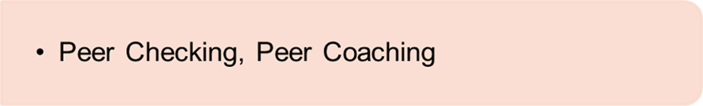

Support the Team
Peer Checking
Watching-out for each other. Peers share
situational awareness and provide
on-the-spot second opinions.
Peer Coaching
Involves feedback. Peers provide a 5:1 ratio of positive to negative feedback to reinforce good habits, extinguish poor habits, and build better practice habits.
Notes:
Peer Checking
This error prevention tool is an easy way to help our coworkers to perform their best. Take advantage of working together to perform fast and easy verifications of each other’s work. Here’s how it works:
• Offer to check the work of others (second‐check a calculation, proofread a memo)
• Point out unintended slips and lapses (a supply room key left on the counter, an order placed in the wrong chart)
• Point out work conditions that your team member might not have noticed (a floor that was mopped and is slippery)
Peer Coaching
This error prevention tool is used to address unsafe or unproductive behavior. Peer coaching is different from “checking.” Coaching requires first observing behaviors and performance of our coworkers then offering coaching where appropriate. Here’s how it works:
• Encourage and praise others when they use safe and productive behaviors
• Discourage and give advice to others when they use unsafe and unproductive behaviors
Holding each other accountable works. Two heads are better than one. Sometimes it is hard to start this behavior, but in the end your co-workers and patients benefit.
It’s like the old saying “TEAM- together everyone accomplishes more”
It may be a life you save.
IT specific example:
Separation of duties – this is a redundancy step built into our workflow to ensure accuracy and prevent failure. In a culture of high reliability this is seen as a valuable step in all we do as opposed to being seen as not being trustworthy. Remember, everyone is capable of error. It is about keeping those errors from turning into events. Peer checking and coaching will increase our reliability by catching those errors before they become events.
Double checks are part of doing the right thing.
Remember the story earlier of the outage caused by the wrong file being loaded. A peer check could’ve prevented that.

Slide 11


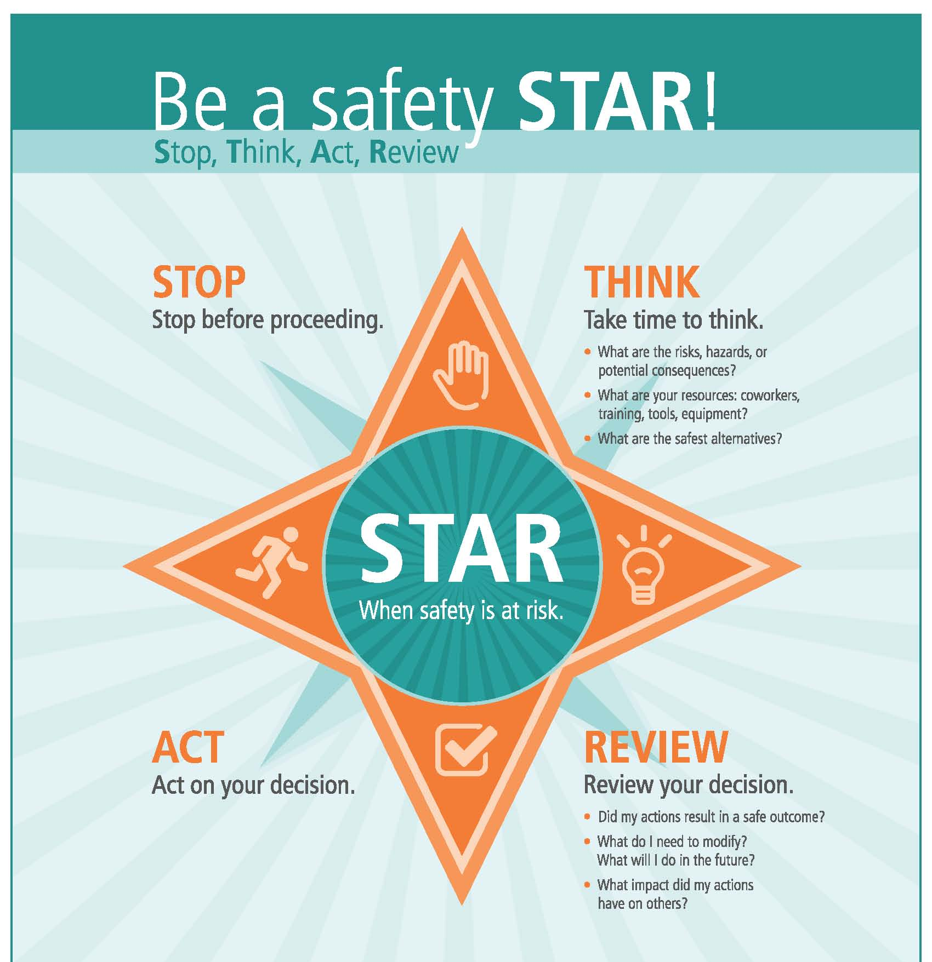
Notes:
Can you identify some times where you might use this?
Backing down a driveway
Putting the lid on your coffee
Labeling specimen
Lifting a patient
Approaching a potentially combative patient
Pouring medications/cleaners/chemicals

Slide 12

Employee Safety
This section identifies ways to protect yourself and your
co-workers by
Wearing the right personal protective equipment (PPE)
Preventing the spread of illnesses to patients or other co-workers
Being alert to physical hazards that exist in a hospital setting

Slide 13
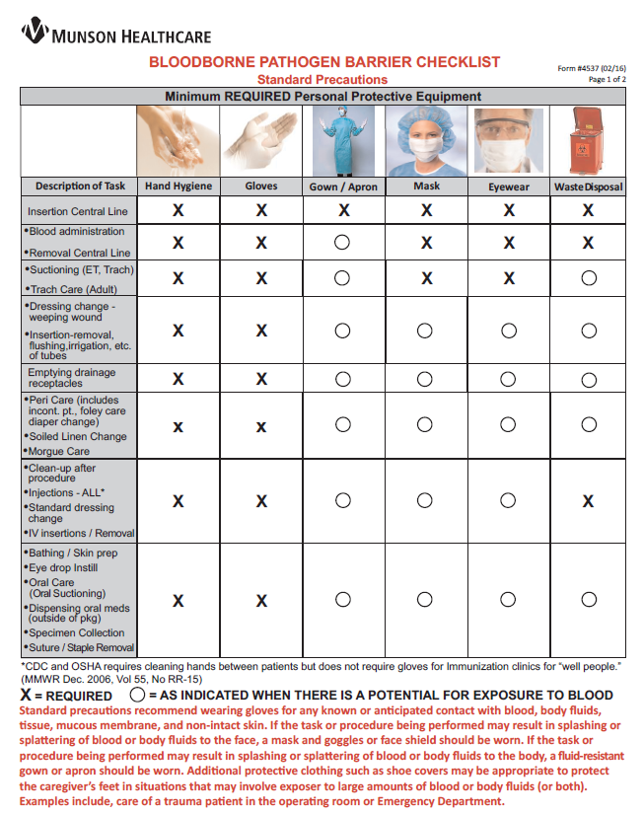
Personal Protective Equipment (PPE)
Proper use of PPE lowers the risk of exposure to bloodborne pathogens.
Gloves protect your skin from blood and body substances.
Goggles and masks protect your face or eyes from splashes.
Gowns protect your skin from fluids.
In each area you provide care, look for a Bloodborne Pathogen Barrier Checklist (at right) for specific guidance on when to use PPE

Slide 14
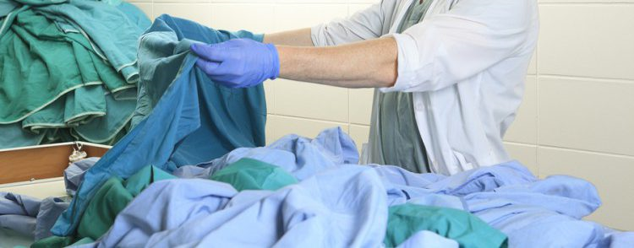
Personal Protective Equipment (PPE)
Proper use of PPE lowers the risk of exposure to bloodborne pathogens.
In the event your scrubs become soiled with blood:
Change into hospital issued scrubs and place contaminated clothes in laundry bag.
Fill out Form #11212 Personal Clothing Contaminated With Blood and staple/tape form to the bag.
Contact the department manager or Nursing Administrative Supervisor to call the Linen Room for pickup.
The clothing will be laundered and returned.

Slide 15
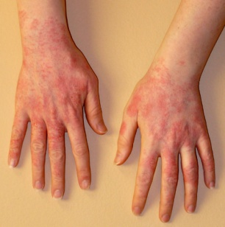
Latex Sensitivity
Latex is a chemical that can cause an allergic reaction.
Symptoms of Latex Sensitivity:
Irritation – redness, burning, itching, pain
Chemical allergy – dry, crusty, hard bumps, sores
Latex protein allergy – moist, pink, raised hives, often whiter in the center
Systemic – swollen eyelids or face, breathing difficulty
Many hospital products have reduced or eliminated latex content
Reaction to Latex:
Employees who suspect that they are having a reaction to latex, must follow the directions on the blue card attached to their I.D. badge.
Patients who have an allergy to latex will wear a green arm band that states, “Latex Allergy.”
LATEX ALLERGY

Slide 16
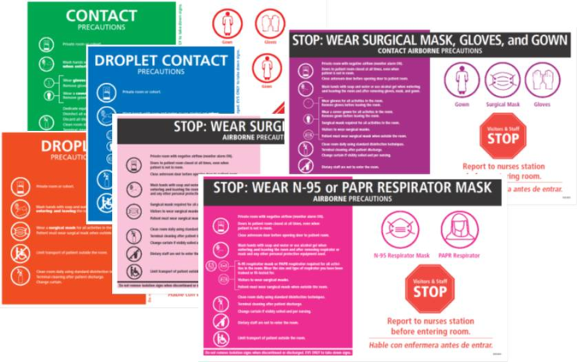
Isolation Precautions
Use Standard Precautions for all patients:
Treat all body fluids as potentially infectious.
Treat contaminated supplies or environment as potentially infectious.
Ask an RN, LPN, or NA for assistance if you have any questions.
Isolation Precautions utilize color-coded door signs for safety
These are special instructions for people who enter rooms of patients with specific illnesses.
Carefully read and follow all instructions on the sign and be sure to use proper PPE

Slide 17

Preventing the Spread of Illness:
Guidance on When to Stay Home…
Employees with these symptoms cannot work until evaluated by a physician or by Employee Health:
Fever of 101 degrees or greater for 24 hours.
Sore throat or identified Group A Strep infection.
Diarrhea or vomiting for 24 hours or longer.
Open wounds that are weeping, draining skin lesions.
Unexplained rash.
Uncontained cough, producing sputum or blood.
Communicable disease (e.g., chicken pox, herpes).
After 3 missed workdays due to illness:
If symptoms persist, employees may not return to work until evaluated by a physician or by Employee Health.

Slide 18

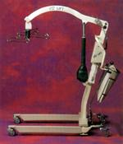
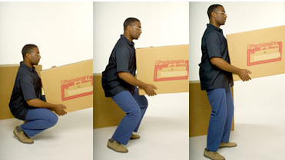
Keeping Yourself Safe: Back Safety
Apply the principles of proper body mechanics at work and at home!
LIFTING LIFT EQUIPMENT POSTURE
Bend knees and squat.
Use your large, strong leg muscles.
Keep object close.
Tighten abdominal muscles.
Use proper lift equipment.
Ask for help when needed.
Keep head and shoulders up.
This keeps spine curves in normal alignment.

Slide 19
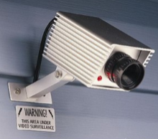
Keeping Yourself Safe: Hospital Security
Security is a shared responsibility for all Munson Healthcare workers.
Employees are expected to know their roles in response to all emergency codes.
Report all incidents, including early warning signs, to ensure appropriate follow-up.
See something, say something!
If you see something suspicious, report it.
If the violence is imminent, likely, or in progress, get yourself to safety and call law enforcement (9-911) immediately. Next, call Security at 5-6700.
For threats to health and life:
Call law enforcement at 9-911.
Call Security at 5-6700.

Slide 20

Keeping Yourself Safe:
Workplace Violence
Munson Healthcare has a zero tolerance policy!
Workplace violence is written, verbal, or nonverbal threats of bodily harm, or intimidation, or physical assault, or battery.
Watch for warning signs of workplace violence.
Early detection and early intervention can help prevent further escalation.
Wear ID badge at all times, including when entering and exiting the hospital.
Report suspicious activity immediately by calling Security at 5-6700.
Park only in employee-designated areas.
Use the buddy system when possible.
Limit and secure personal valuables.
Do not allow unauthorized persons access to locked areas.
Employees and physicians are responsible for knowing and adhering to the Code of Conduct Policy.

Slide 21

Keeping Yourself Safe: Chemical Safety
Everyone is required to know which chemicals are used in their specific work environment and how to handle chemicals safely.
Safety Data Sheets (SDS) explain the hazards associated with use of chemicals and the recommended personal protective equipment (PPE) to be used when working with the chemicals.
OSHA’s Hazard Communications Standard mandates the right to know about hazardous chemicals in the workplace. Chemicals are hazardous when they are explosive, flammable, corrosive, or can cause acute and/or chronic health problems. They must be stored in properly-labeled containers.
MMC Intranet>Applications and Resources>Supplies>
Safety Data Sheets or
Call 3E Company
1-800-451-8346
How to obtain an SDS?

Slide 22

Environmental/Organizational Safety
Properly disposing of all types of waste and using care when around chemicals, gas cylinders, or electrical equipment
can help prevent environmental safety risks.
Knowing how to quickly respond to fires or other emergencies can help prevent injuries or death.

Slide 23
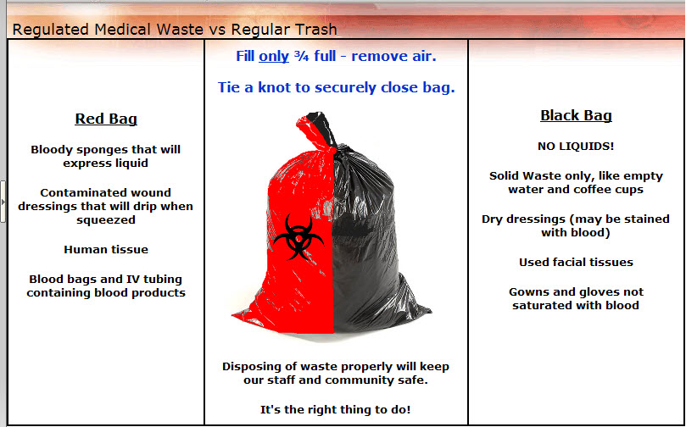
Disposing of Waste:
Red Bag or Black Bag?

Slide 24
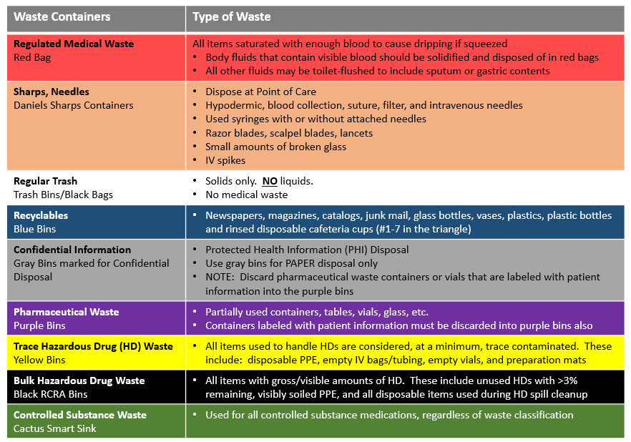
Disposing of Waste Properly
Do the Right Thing, Every Time

Slide 25
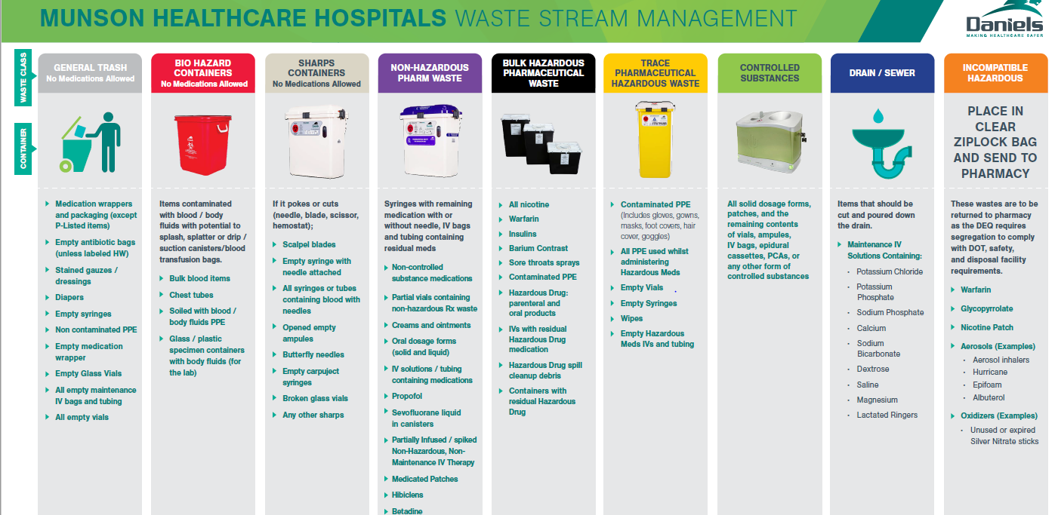
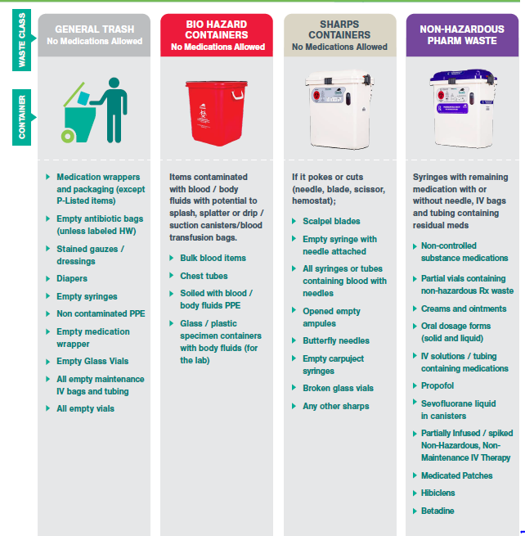
Disposing of Waste Properly

Slide 26
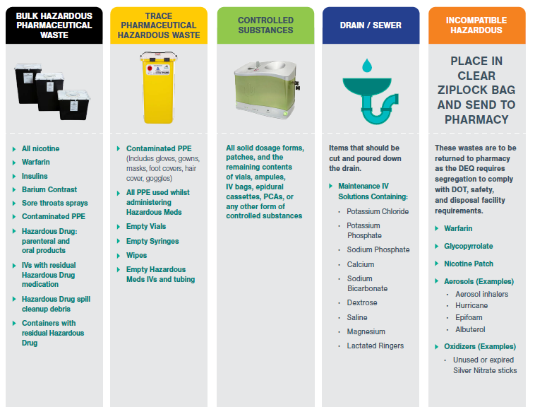
Disposing of Waste Properly

Slide 27
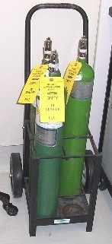
Gas Cylinder Safety
Compressed gas cylinders can become dangerous projectiles!
Proper storage:
Properly secure all cylinders, both full and empty.
Store in dry, well-ventilated areas and away from sources of heat.
Separate FULL, IN SERVICE, and EMPTY cylinders.
Don’t keep more than 12 oxygen cylinders in one place.
Proper transport:
Never drop, roll, drag, or allow cylinders to strike each other.
For cylinders with caps, remove the regulator and replace the cap before moving.
Use appropriate trolleys to move cylinders.
Report all violations:
Report to the manager of the department where you find it.
Report through VOICE online

Slide 28
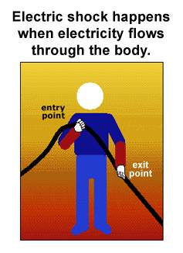
Electrical Safety
Protect yourself when handling equipment.
Conduct a basic safety check of all equipment before use. Take time do to this!
  Check the plug – are there three straight prongs?
  Are there any cracks, tears, or cuts in the insulation of cords or wires?
  Is the cabinet or case damaged, cracked, or loose?
Never handle equipment with wet hands.
Turn equipment off before unplugging.
Do not yank on cords. Grasp the plug firmly when removing a power cord.

Slide 29
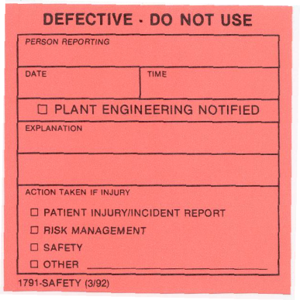
Electrical Safety
(cont.)
Report unsafe electrical equipment.
Remove from service.
Label with a completed red sticker.
Save all equipment, disposable parts, and packaging for the investigation.
If a patient injury is involved or if a sentinel event has occurred, save the device, including parts and packaging, notify the department manager, and report in the online reporting system, VOICE.
Notify Plant Engineering at 5-6166 or use the online Plant Engineering Work Order request. Provide the following:
    Equipment tag number
    Your name, phone number
    Department number
    Description of problem
    Urgency of the request
New, rental, or personal equipment coming into the hospital must be inspected for electrical safety and approved before use.

Slide 30




In the event of a fire,
R.A.C.E. for safety!
Rescue/Remove
  Rescue persons in immediate or life-threatening danger.
Alarm
  Activate the alarm. Use the fire pull at Munson Medical Center.
  Shout “Code Red!”
Contain
  Contain the fire. Close all doors and windows.
  Check for evidence of heat, smoke, or fire before passing through closed fire doors. Proceed with caution.
Evacuate or Extinguish
  Prepare to evacuate when authorized by Incident Command. Evacuating should occur horizontally first (i.e., on the same level, to another area, behind a fire door). Vertical evacuation (i.e., down stairs) shall only occur as directed.
  Use a fire extinguisher only if trained and only on small fires.

Slide 31
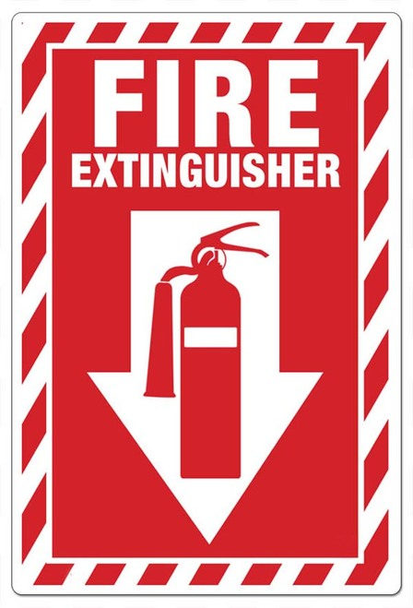
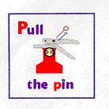
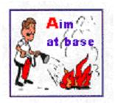
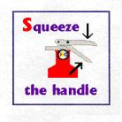
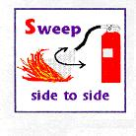
To Put Out a Fire with an Extinguisher: Use the P.A.S.S. Method

Slide 32
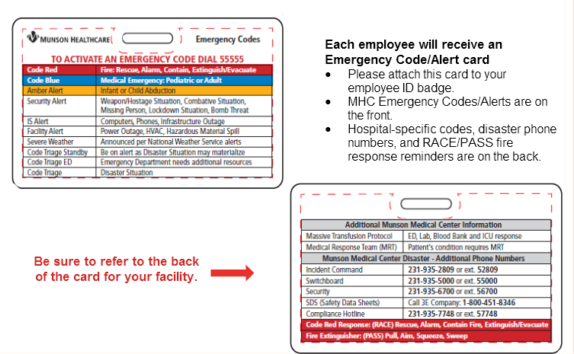
Emergency Code Response Know YOUR Role!

Slide 33
Emergency Code Response:
An Important Element of Safety
Know YOUR Role!

Slide 34

Patient Safety
Building on our value of respect, we value diversity and seek to improve the patient experience. Patient rights and the National Patient Safety Goals (NPSG) help build the foundation for patient safety at Munson Medical Center.

Slide 35

Diversity
We are all unique individuals, deserving of respect.
Our Hospital Value of Respect:
We respect everyone, everywhere, everyday
Respect each person:
Caregivers may form biases and hold stereotypes based on past experiences, which could affect their ability to provide culturally-sensitive care.
Take time to evaluate yourself for biases and stereotypes.
Make a conscious effort to treat each person as a valued individual.
Listen with the purpose of understanding.
Values, beliefs and practices are often similar within cultural groups, but may not be held by every member of that cultural group. Treat all people with respect and as individuals.

Slide 36
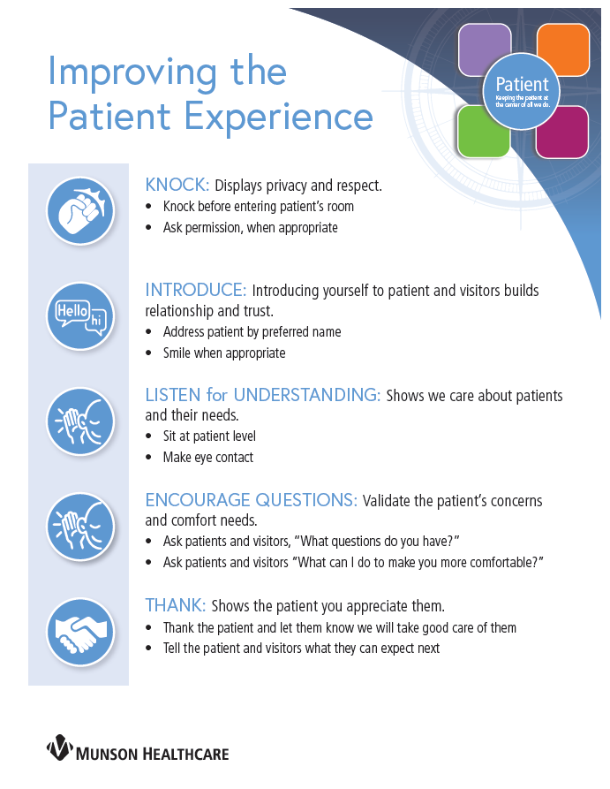
Providing a positive patient experience and keeping the patient central to our work is a basic principle of True North!
Building rapport with patients and their visitors is essential to creating an environment that feels safe. Improving the patient experience depends on YOU!
There are five consistent ways we want to improve the patient experience:
Knock
Introduce
Listen
Encourage
Thank
Notes:
Pulling in patient experience with behaviors.
We want to set a foundation to let patients speak up and ask questions.
The patient experience is a vital part of the healing process and the HCAHPS survey provides us with invaluable feedback. The score is the measurement used for our True North and keeping the patient in the center of all we do. The survey identifies opportunities for improvement and we are always working on initiative that will continue to enhance the patient experience. We are implementing specific behaviors that we are asking staff to use when interacting with patients. What we are trying to ensure is that patients have the same kind of experience no matter where they’re being treated in our system. The following tool is an example of the specific behaviors used to impact the patient experience in a positive way. Each of the behaviors correlate with specific questions asked on the survey. When used consistently you will see an increase in our overall patient experience scores.

Slide 37
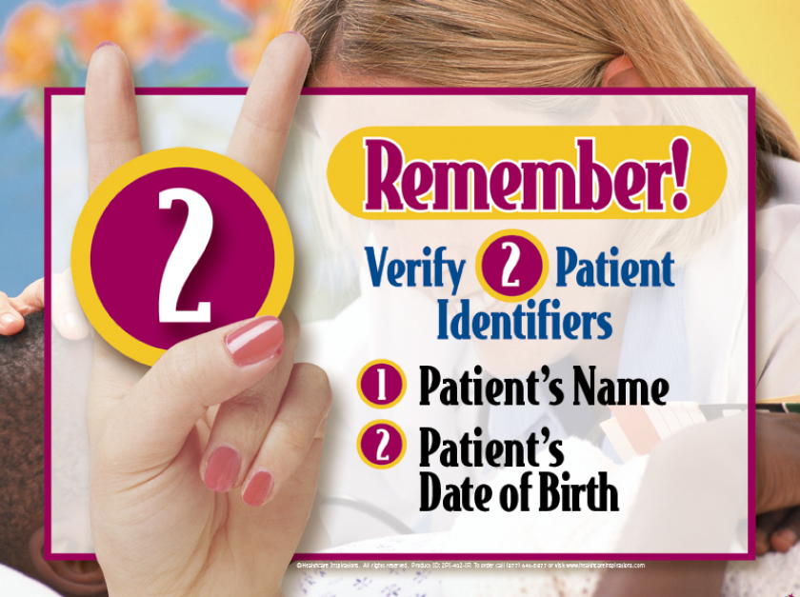
National Patient Safety Goals
The Joint Commission (TJC) is a body for reviewing and accrediting hospitals. They focus on quality and safety of the hospital. TJC identifies key areas of focus. These are called National Patient Safety Goals (NPSG). See the list below for examples:
Use at least two patient identifiers when providing care, treatment, and services (first and last name, birth date).
Verify the administration of any blood transfusions with a two-person process.

Slide 38
National Patient Safety Goals
The Joint Commission (TJC) is a body for reviewing and accrediting hospitals. They focus on quality and safety of the hospital. TJC identifies key areas of focus. These are called National Patient Safety Goals (NPSG). See the list below for examples:
Report critical results of test and diagnostic procedures on a timely basis.
Maintain and communicate accurate patient medication information (Medication Reconciliation).
Comply with the Centers for Disease Control and Prevention (CDC) hand hygiene guidelines.
Identify patients at risk for suicide.
Implement evidence-based practices to prevent healthcare-associated infections due to multidrug-resistant organisms (MDRO) in acute care hospitals.
Implement evidence-based practices to prevent central line-associated bloodstream infections (CLABSI).
Implement evidence-based practices to prevent indwelling catheter-associated urinary tract infections (CAUTI).

Slide 39
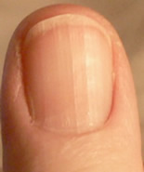
National Patient Safety Goal:
Hand Hygiene
Hand Hygiene is the single most important thing we can do to stop the spread of infection in the hospital!
For patient safety, staff safety, and quality care, every staff member in every department is expected to use alcohol-based hand rub or soap and water:
Every time you enter a patient room, even if you just did so when leaving the last patient room. Do hand hygiene in view of the patient, if possible.
Every time you exit a patient room, even if you did not come in physical contact with a patient, even if you have been wearing gloves.
Clinical Staff: Keep your nails free of dirt and trim nails to less than ¼ inch in length. Artificial nails are prohibited for infection control reasons. Nail polish is not allowed on some units.

Slide 40

National Patient Safety Goal:
Hand Hygiene
Hand Hygiene is the single most important thing we can do to stop the spread of infection in the hospital!
Soap and Water Method:
Use this method when hands are visibly soiled, before eating, drinking or handling food, after using the restroom, blowing your nose or covering a sneeze.
Apply soap.
Rub hands together for 15-30 seconds.
Rinse with a stream of warm water.
Dry with paper towel.
Use paper towel to turn off the faucet.

Slide 41
National Patient Safety Goals
The Joint Commission (TJC) is a body for reviewing and accrediting hospitals. They focus on quality and safety of the hospital. TJC identifies key areas of focus. These are called National Patient Safety Goals (NPSG). See the list below for examples:
Implement evidence-based practices for preventing surgical site infections.
Use alarms safely. Ensure that alarms on medical equipment are heard and responded to on time.
Conduct a pre-procedural verification process. Ensure that the patient is involved in the verification process when possible.
Mark the procedure site before the procedure is performed and, if possible, with the patient involved.
Conduct a time-out immediately before starting the invasive procedure or making the incision.
Label all medications, medication containers, and other solutions on and off the sterile field in perioperative and other procedural settings.
Reduce the likelihood of patient harm associated with the use of anticoagulant therapy.

Slide 42

Identifying Victims of Abuse, Neglect, and Exploitation
Abuse, neglect, exploitation, or assault of patients will not be tolerated!
If abuse, neglect, exploitation, or assault is suspected or identified, hospital personnel MUST report such cases.
Failure to report opens the employee up to criminal and/or civil liability. Notification to the Department of Human Services must be made.
Contact the Administrative Supervisor or Medical Social Work team for assistance in reporting.

Slide 43

Recipient Rights for
Behavioral Health Patients
Patients should inform a Recipient Rights Advisor if they feel their rights have been violated.
Healthcare providers may assist patients by calling the Patient Liaison or Risk Management Department.

Slide 44
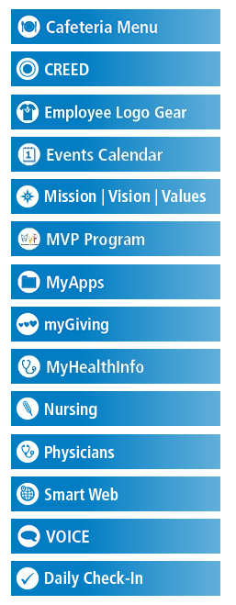
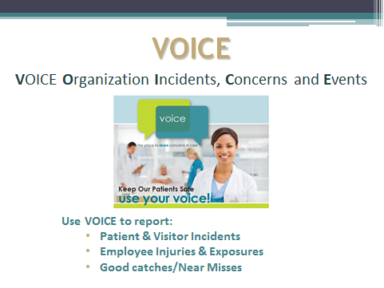
How Should I Report an
Injury, Exposure, or Near Miss?
Steps to Reporting:
Visit the Munson Intranet Page
Select VOICE from the menu on the left hand side
Follow the prompts to report your concern
For serious concerns where applicable law or regulations may have been broken,
you can simultaneously or alternatively report issues to :
Munson Healthcare Corporate Compliance Hotline at (231) 935-7748

