Slide 1
Mammography Breast Imaging Order
September 2017

Slide 2
Outline
Overview of new process for ordering breast procedures
Guidelines outlining the new “conditional order” process
3D Mammography Orders
Specific process descriptions
Summarize the goals of implementation

Slide 3
Mamm Conditional Order
Overview & Guidelines

Slide 4
Overview
The CR/MMC Breast Imaging Standing Order process is no longer valid and is being replaced with a new Breast Imaging Conditional Order that has been approved by the MHC legal team.
The “new conditional order” will become the standard mammography order and replace the existing standard order in most cases.
If the old standard mammography order is used instead of a “Conditional Order”, each follow up care exam will need an additional order. Surgical consults and biopsy results both require a signed Conditional Order.

Slide 5
Guidelines
The current standard radiology order may still be used for ordering breast procedures, but that standard order does not allow for continued follow up, biopsy results provided or surgical consults set up for patients.
3D mammography requires a specific order for the 3D mammogram. This option is provided in a 3D checkbox following the initial exam checkbox.
Providers must complete and sign the “Conditional Order” information if they desire their patients to receive follow up care from screening exam to diagnostic imaging and/or biopsy.
This conditional order will also provide a selection to give or not give permission to provide your patients with biopsy results and/or scheduling of a surgical consultation.
The Conditional Order allows providers to choose or not choose to give authority to the performing facility to order and perform additional follow-up tests/results/and or surgical consults if needed for 13 months.
Both the standard or Conditional Order requires a new order 13 months after the initial exam.

Slide 6
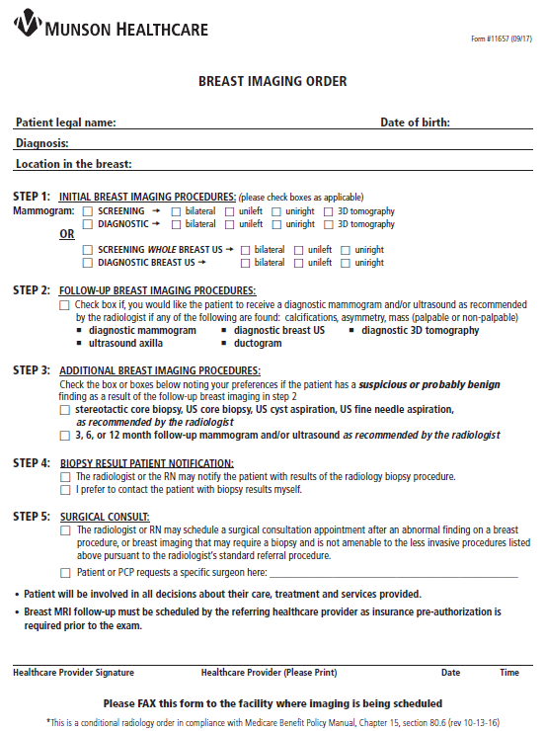
Breast Imaging Order
Step 1: Initial Procedures
Screening or Diagnostic breast imaging with or without 3D
Step 2: Follow-up Procedures
Diagnostic, 3D, US, MRI
Step 3: Additional Procedures
Biopsy, Stereotactic, US, Follow-ups
Step 4: Biopsy Result Notification
Choice of nurses at the Breast Center or results provided by the Ordering Provider
Step 5: Surgical Consult
Standard referral or request a specific surgeon
Signature with Date/Time
Fax to Imaging Facility

Slide 7
3D Mammography
Details Up Next….

Slide 8
3D Mammography
At initial go live all 3D breast imaging to be scheduled by SFBHC Mammography Schedulers 231/935-2185
Medicare and Medicare Advantage will provide coverage
Patients without Medicare or Medicare Advantage will sign a non-coverage letter
MMC OOP $157.30 and GTR $91
Questions regarding GTR billing: 877/850-1244
Pre-Registration & Scheduling to offer to collect payment on MMC $157.30 only
If Medicare or Medicare Advantage is secondary payor = patient signs an NCL
3D can be done in Screening or Diagnostic Mammography
Patients wanting to call their own insurance plan
CPT Code Screening 3D is 77063
CPT Code for Diagnostic 3D G0279
Orders for 3D need supportive DX for both the mammogram and the need for 3D
Currently there is limited availability of 3D mammography with only one 3D unit installed at the Smith Family Breast Health Center in Traverse City.

Slide 9
Supporting Diagnosis for 3D Mammography

Slide 10
3D Mammography Exam Names
MA MAMM 3D SCREENING BIL
MA MAMM 3D SCREENING LT
MA MAMM 3D SCREENING RT
MA MAMM 3D DIAGNOSTIC BIL
MA MAMM 3D DIAGNOSTIC LT
MA MAMM 3D DIAGNOSTIC RT

Slide 11
BENIGN Biopsy Result Notification

Slide 12
Malignant Breast Biopsy Notification

Slide 13
Summary of Processes
New Breast Imaging Order implemented for C/G/K/P/TC
Electronic version available in NextGen, eCW, Aria, and gloStream (GTW)
Fax order per current process
Non-Hosted resources may be available
PWS Conditional Order section on Questionnaire, print on QES (hospital scheduling software) Order
QES electronic tracking via Fax Viewer, link order to initial appointment

Slide 14
Electronic Orders
Mamm Conditional Order Examples

Slide 15
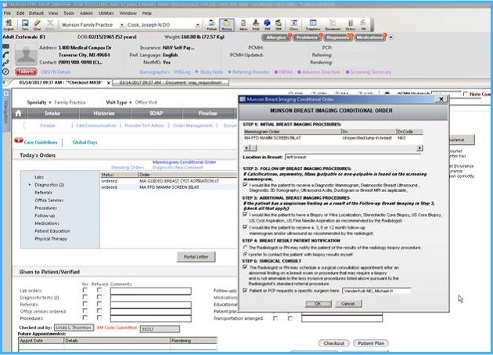
NextGen

Slide 16
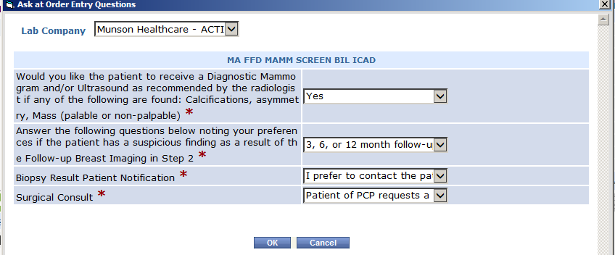
eCW

Slide 17
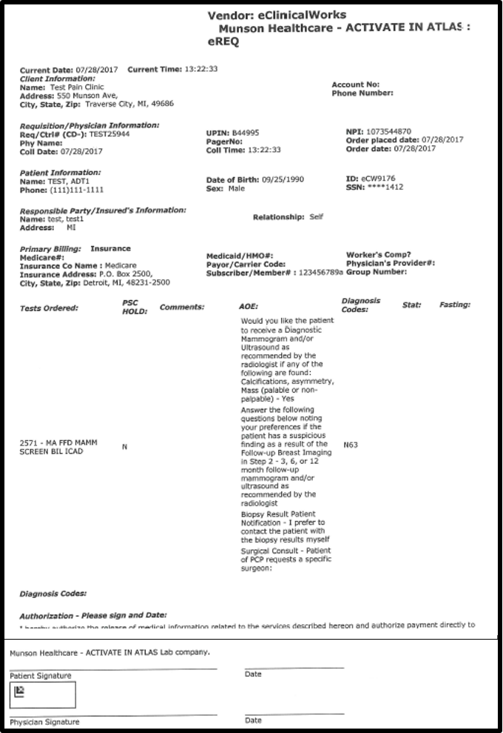
eCW Requistion

Slide 18
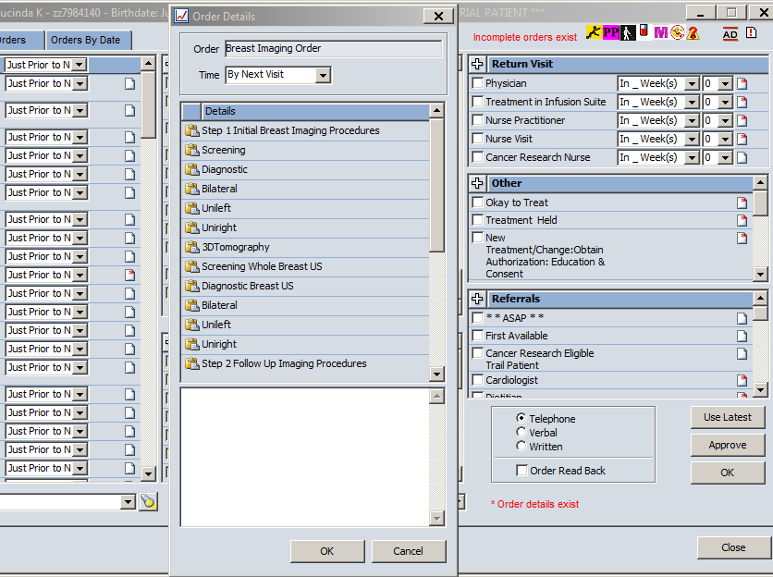
Aria

Slide 19
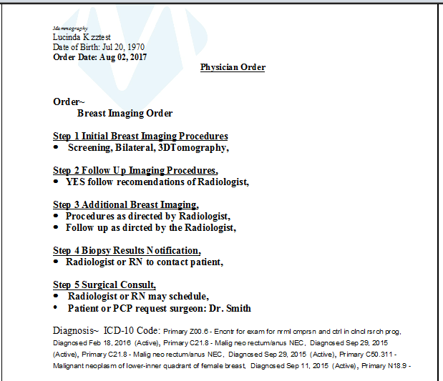
Aria Requisition

Slide 20
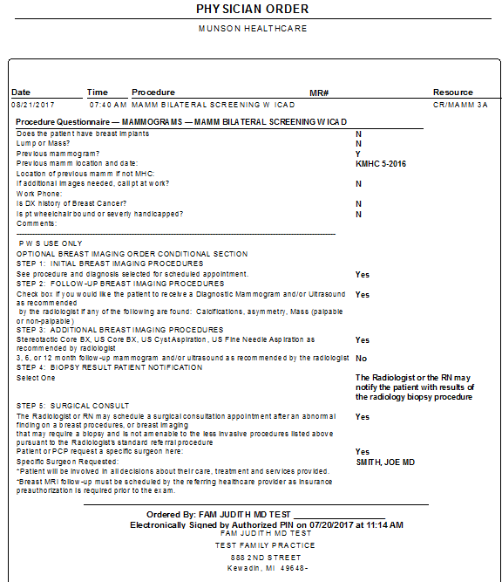
PWS

Slide 21
Summary
Provide a compliant solution which offers efficiency to providers and improves patient care.
Replace current state electronic processes with non-paper processes utilizing the EMRs and scheduling systems.

